Slide 1
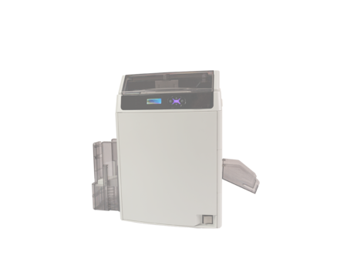
How to print
YMCKK
Printer Driver Ver. 10.117.0.9 Card Editor Ver. 19.01.08.28
- It is explained in English version.
- Selecting buttons at the same location
when installing other languages
March 15, 2021

Slide 2
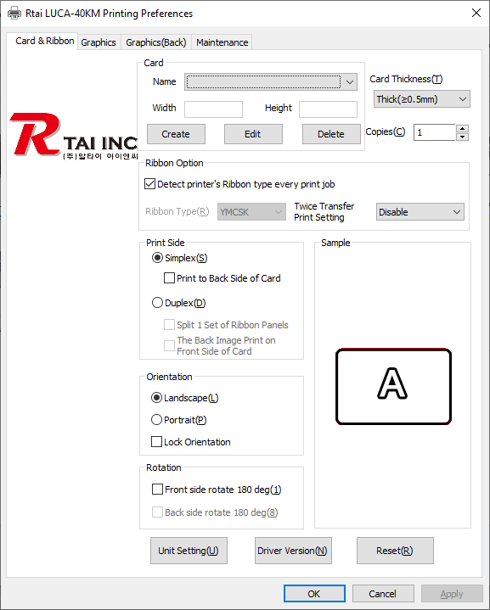
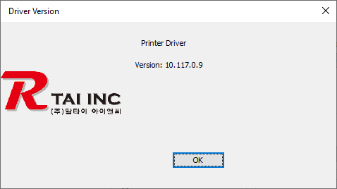
Version check (Printer Driver)

Slide 3
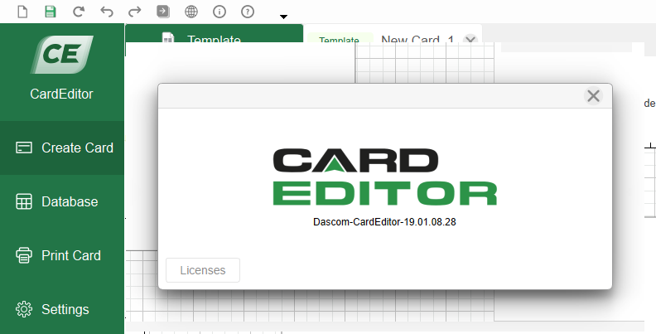
Version check (Card Editor)
March 15, 2021

Slide 4
Download drivers and software
Click on the hyperlink below
WWW.RTAI WORKS.COM
Download Site

Slide 5
1. Select card size (step-1)

Slide 6
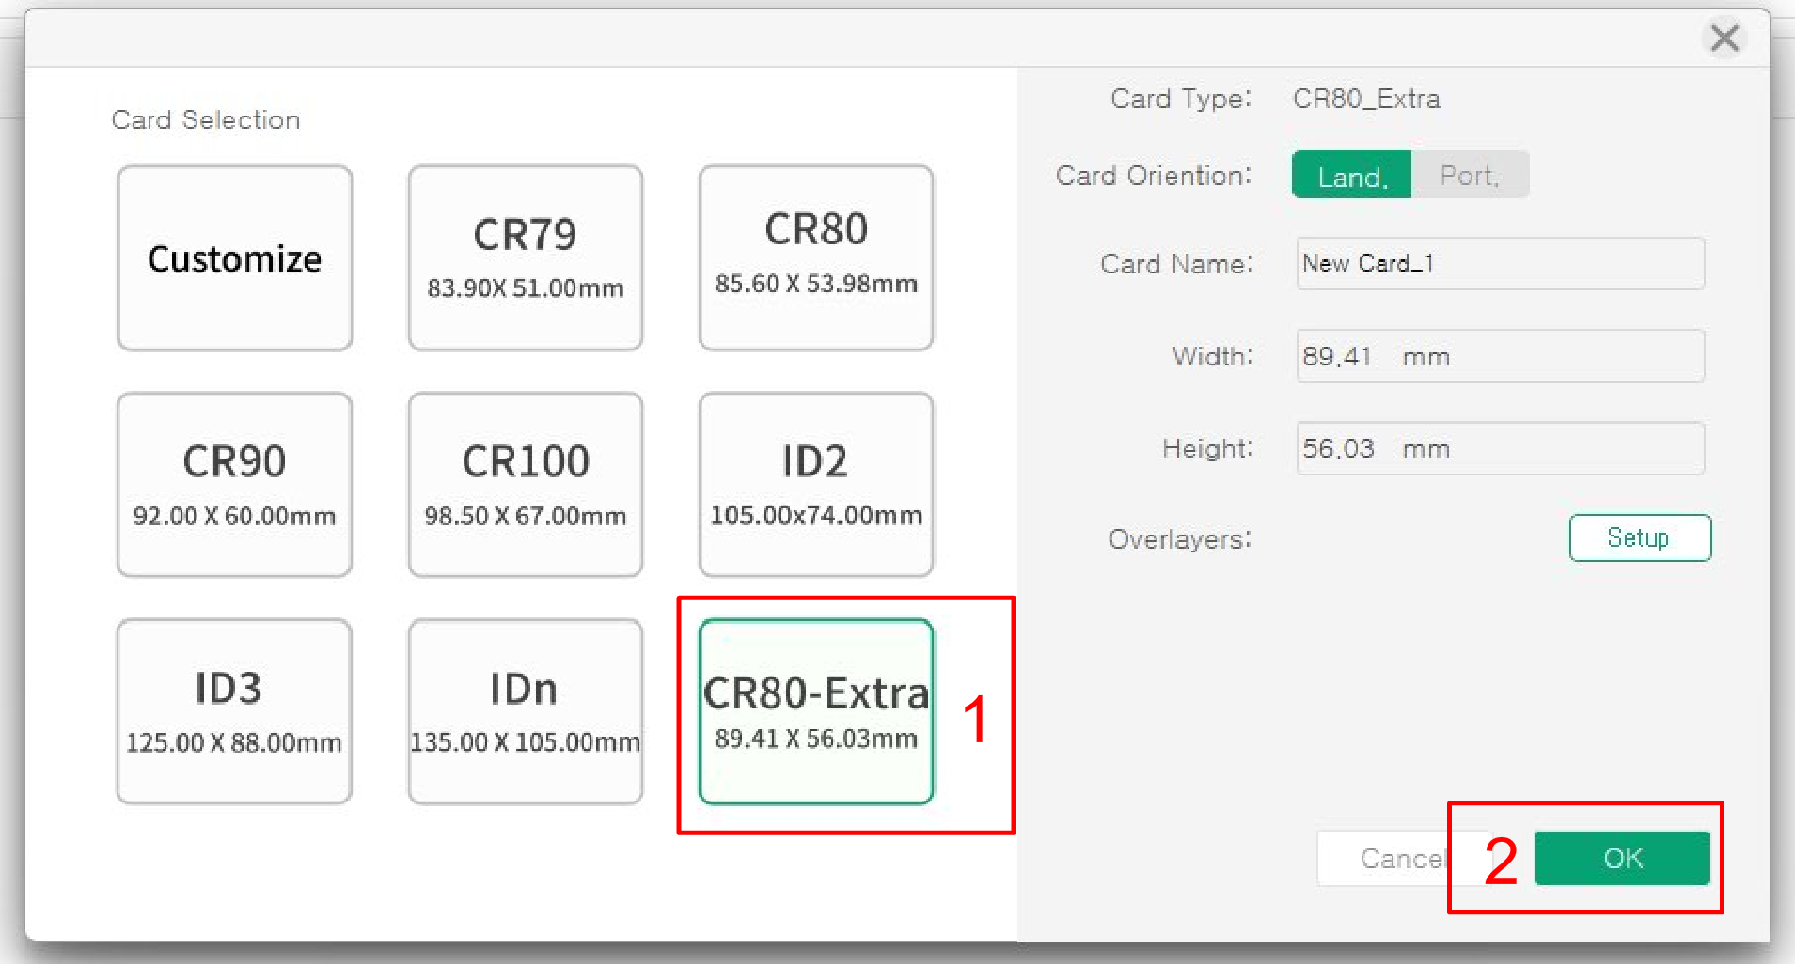
1. Select card size (step-2)

Slide 7
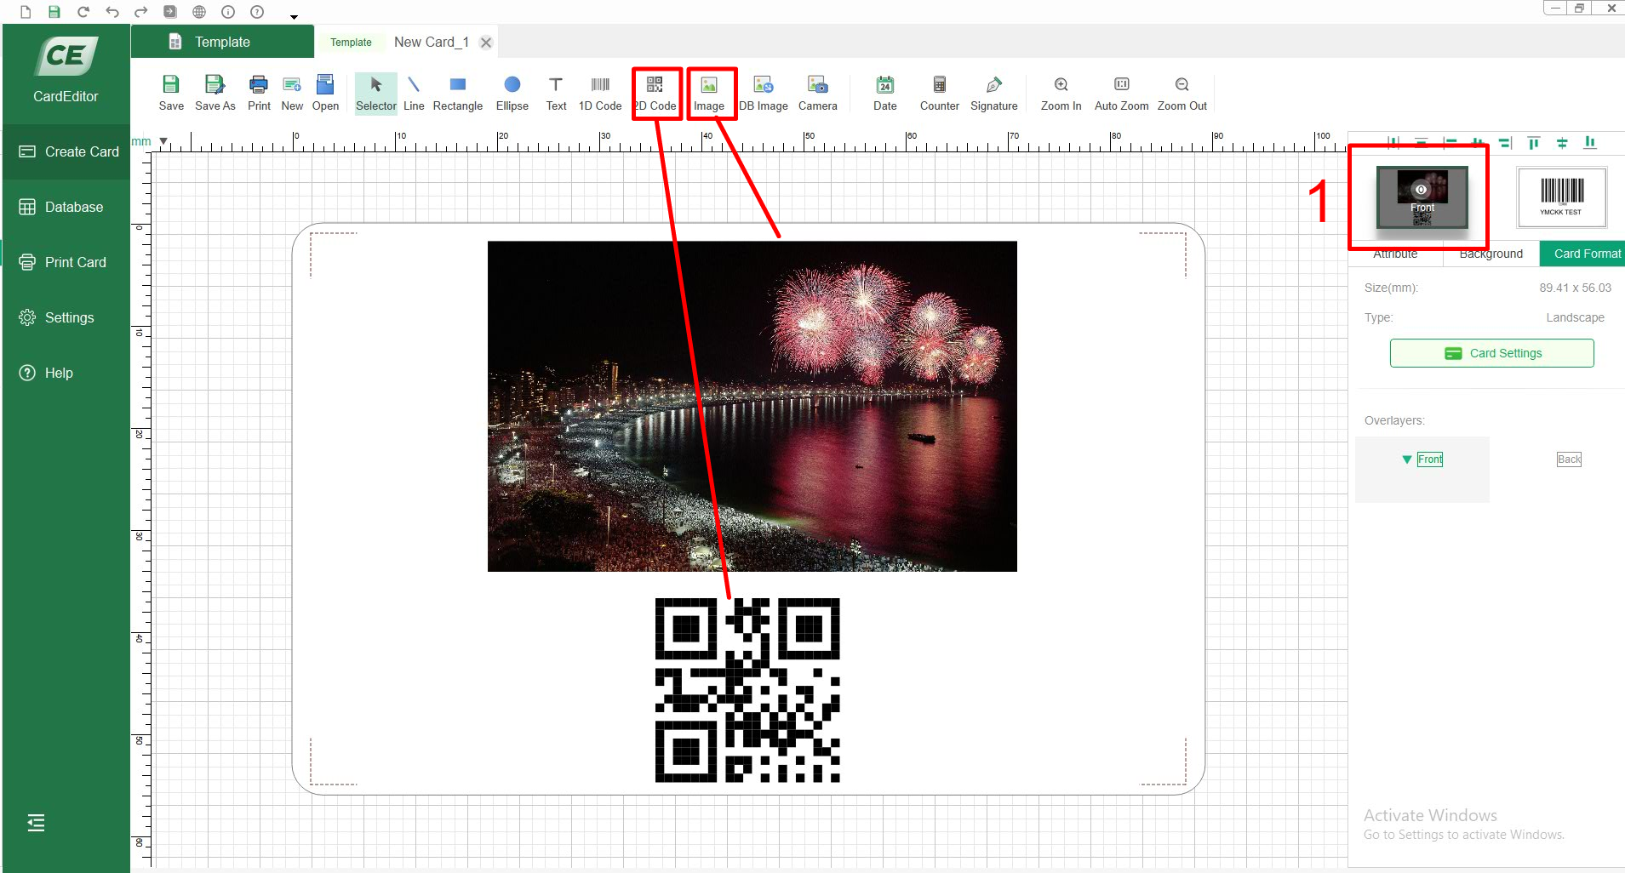
2. Design the front side with color and text and bar code

Slide 8
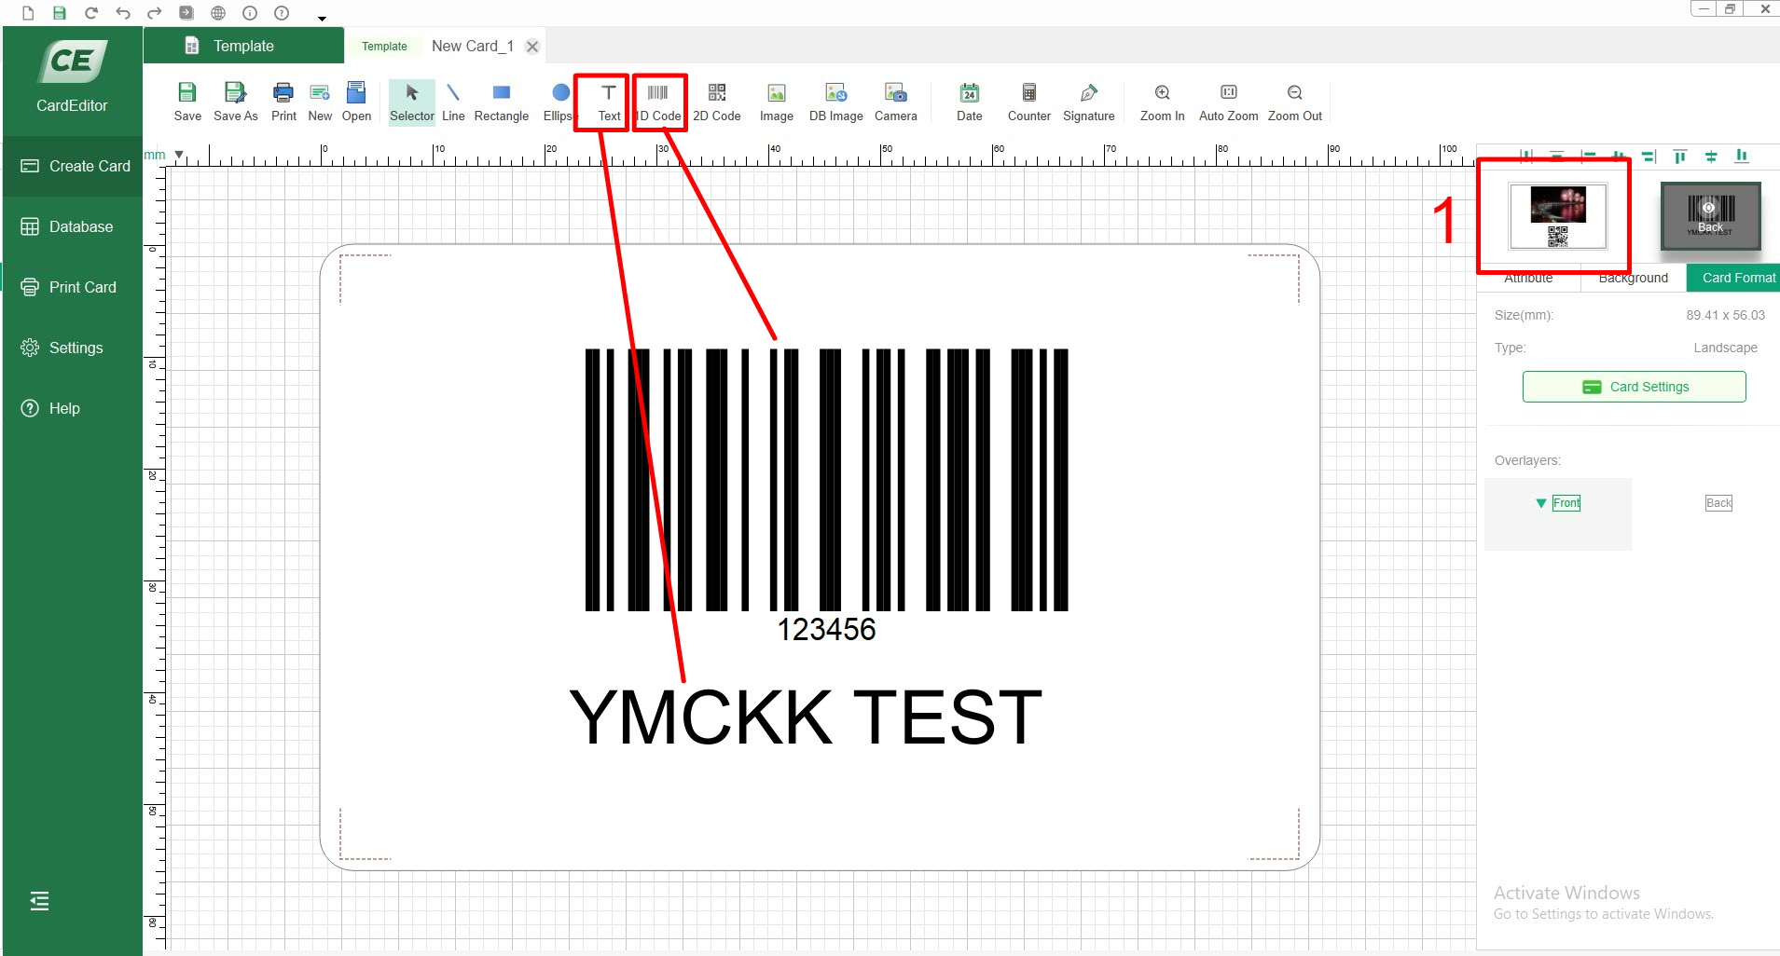
3. Design back side to print by K panel (Text, bar code and QR code)

Slide 9
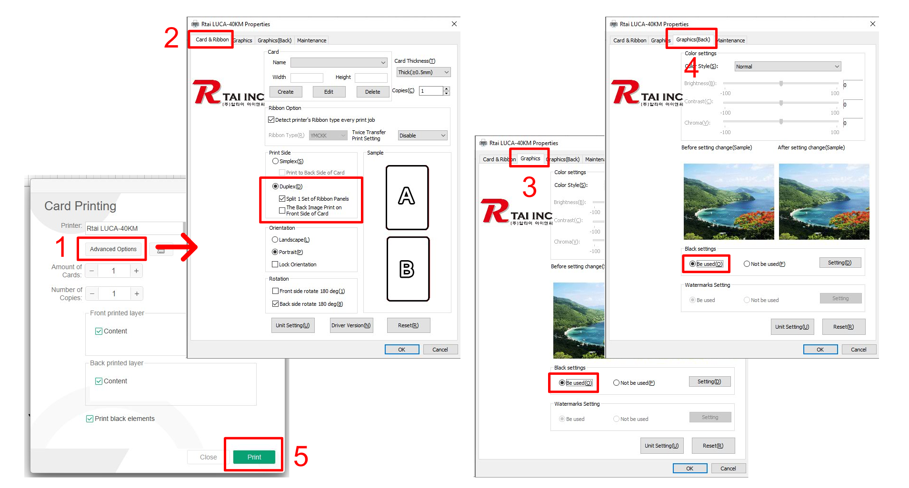
3. Printer Driver settings
Change printer driver settings
Change Card Editor settings
Note : Make sure to Check: v Split 1 Set of Ribbon Panels. If it is checked, double side prints could be possible by YMCK ribbon. Front side by YMC and Back side by K panel.

